Slide 1
Using Graphic Novels in your Classroom
By: Amanda Lindquist

Slide 2
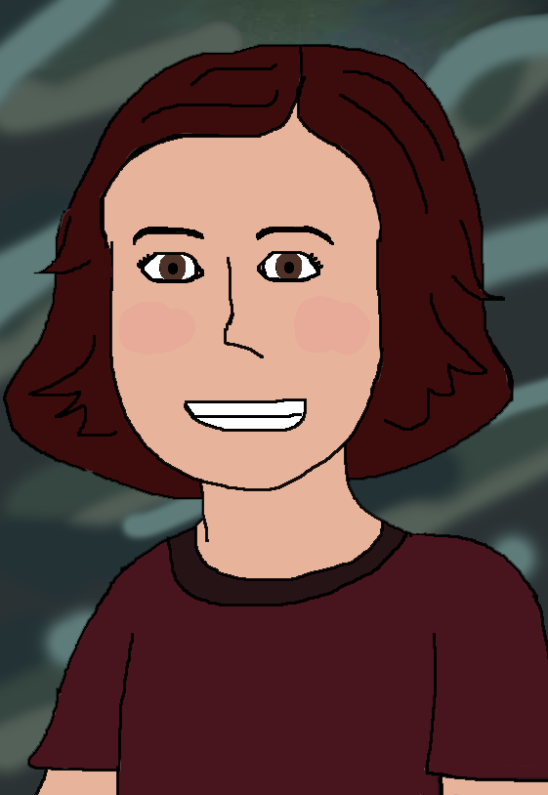
Who am I?
5th Year Middle school teacher
Focus on English Language Arts
Previously taught Art, Spanish, English, Religion, and Computers at a private school
Currently at Superior Middle School
Masters project on Graphic Novels
How do they work in the classroom?
Do they motivate students?
Requested to present about graphic novels at this conference

Slide 3
Who am I?
For more ideas, visit my website:
teaching.casadelindquist.com/

Slide 4
What will we be doing today?
Defining what makes a graphic novel
Research behind using them in the classroom
How to incorporate them into your classroom
Quick lesson on creating a graphic novel
Notes:
Note: this presentation is from the perspective of an English teacher with some experience teaching art. I will do my best to make it relate to you.

Slide 5
Defining graphic novels

Slide 6
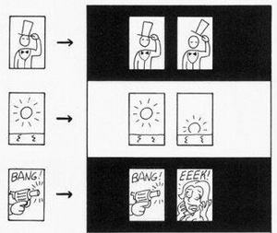
What is a Graphic Novel?
Defining Comics*
Sequential art
Side-by-side images
Deliberate sequence
Conveys information
Produces an aesthetic response
Defining Graphic Novels**
A comic long enough to have a spine
McCloud (1993). Understanding Comics.
Notes:
Notice the differences between the two columns of the graphic.
The first column shows a singular picture. It is not sequential and does not tell a story. This would be similar to a single panel cartoon. It is related to comics in the style but is not in itself a comic.
The second set is sequential, telling a very short story.
This is the visual difference between a drawing and sequential art.
A graphic novel is a comic that tells a long enough story that it requires a spine (like a book). It tells a story through graphics and text with a beginning, a middle, and an end.
*Source: McCloud, S. (1993). Understanding comics: The invisible art. New York: William Morrow.
**Source: Yang, G. (2008). Graphic novels in the classroom. Language Arts, 85(3), 185. March 10, 2013. Retrieved from http://intranet.ecu.edu/cs-lib/trc/upload/Gene_Yang_article.pdf.

Slide 7
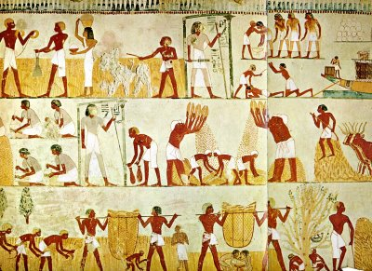
Comics: A Brief History
1300BCE – Egyptian Paintings
Painted scene in the Tomb of “Menna”

Slide 8
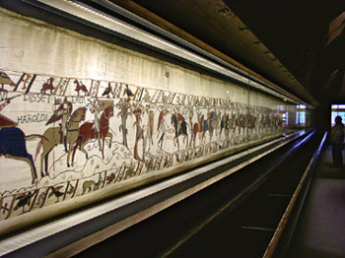
Comics: A Brief History
1049AD – Ancient Mexican civilizations
Painted screenfolds tell political and military stories
1066AD – Norman Conquest of England
230 foot long Bayeux Tapestry
Notes:
The Egyptian paintings were read zigzag from bottom to top. When put together, they formed a juxtaposed story.
Ancient Mexican civilizations (such as the Mayans and Aztecs) had various forms of images that when put side-by-side told a story. A set of painted screenfolds told stories of military battles and politics.
Finally, the picture on the right shows a picture of part of the 230 foot long Bayeux Tapestry of the Norman Conquest of England. Again, when the images are side-by-side, they tell a story.
Source: McCloud, S. (1993). Understanding comics: The invisible art. New York: William Morrow.

Slide 9
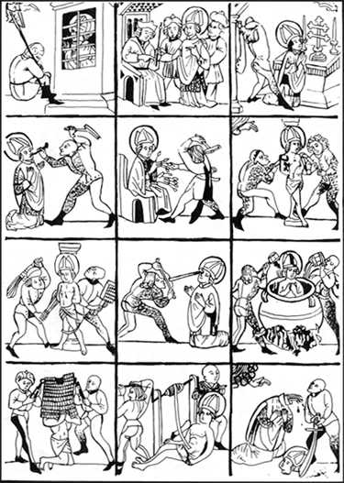
Comics: A Brief History
1460AD – The Tortures of Saint Erasmus
Printing press brought art-form to all
1731AD – A Harlot’s Progression
Series of 6 paintings by Hogarth
Notes:
The printing press, invented by Johannes Gutenberg in 1450, opened up the accessibility of printed art to everybody. Previously, only the rich could afford it.
“A Harlot’s Progression” by Hogarth was intended to be seen side-by-side to share the story. An early example of comics.
Rodolphe Topffer is considered the father of the modern day comic because he was one of the first to use caricature drawings and comic panels. He started drawing to entertain his students and friends. Later, his works were compiled into books and sold.
In the 20th Century, a variety of comics became popular ranging from the superhero style comic books (Batman, Superman, Spiderman) to the funnies found in newspapers to Japanese manga.
Source: McCloud, S. (1993). Understanding comics: The invisible art. New York: William Morrow.

Slide 10
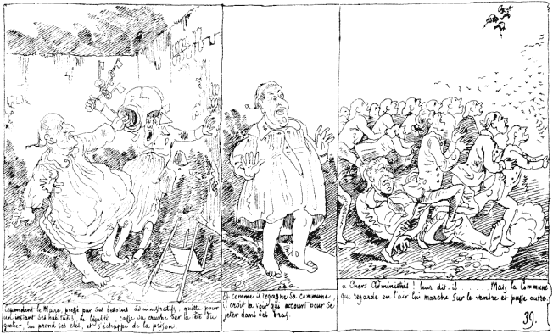
Comics: A Brief History
1800’s – father of the modern comic
Rodolphe Topffer: cartooning & panel borders
20th Century – Comics gain popularity
Appear in newspapers, magazines, & books

Slide 11
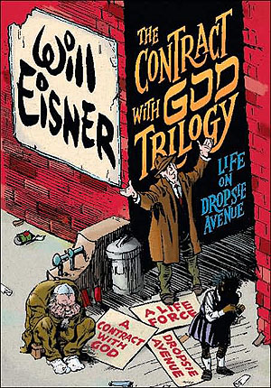
Graphic Novel: A Brief History
1964 – Term first used
1978 – Will Eisner popularizes term
Publishes A Contract with God
1980s – More familiar to the public
Maus by Art Spiegelman
Watchmen by Moore and Gibbons
The Dark Knight Returns by Miller
21st Century – recognized by BISG
Notes:
The term “graphic novel” is first coined in 1964 by Richard Kyle who made a distinction between comics and novels with images and text.
Will Eisner is given credit for popularizing the term with his book A Contract with God, labeling it as a graphic novel.
As books like Maus by Art Spiegelman gained popularity and recognition, people became even more aware of graphic novels, bringing them into the academic world.
The Book Industry Study Group, Inc. (BISG) is a U.S. trade association for policy, technical standards and research related to books and similar products. They officially recognized graphic novels as a category in book stores at the start of the 21st Century.
Source: McCloud, S. (1993). Understanding comics: The invisible art. New York: William Morrow.

Slide 12
Research Behind Graphic Novels in the Classroom

Slide 13
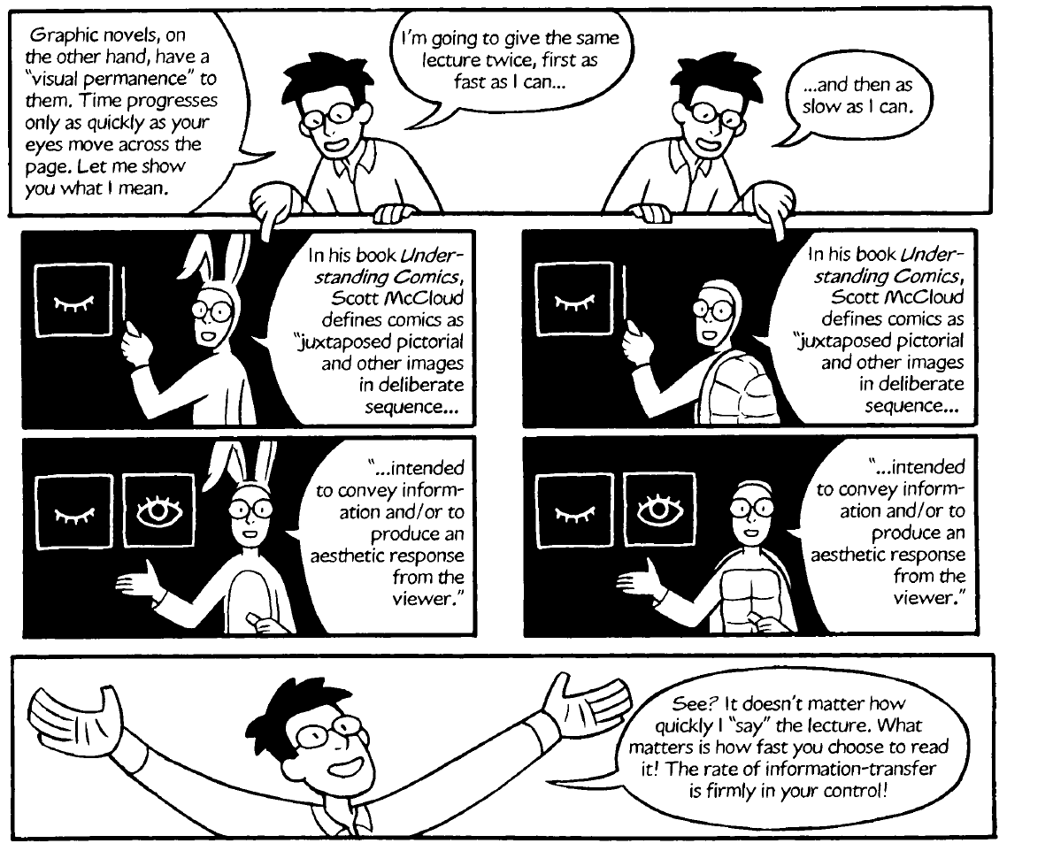
Benefits
Notes:
Above is an example by Yang (2008) of the permanence of a graphic novel versus moving picture. Because students are reading at their pace, it doesn’t matter if they read it quickly or slowly. They will be able to go back and reread if necessary. This allows students to monitor for comprehension.
Source: Yang, G.(2008).Graphic novels in the classroom. Language Arts, 85(3), 185.March 10, 2013.Retrieved from http://intranet.ecu.edu/cs-lib/trc/upload/Gene_Yang_article.pdf.

Slide 14
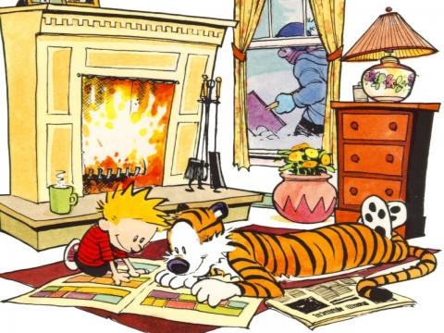
Research Question
Best practices in teaching literacy
Middle school educational setting
Motivation
Especially struggling readers
Using graphic novels
Calvin and Hobbes by Bill Watterson
Notes:
Research Question - In light of what we know about how children learn and educational policy and practice, how shall we best teach literacy in middle school educational settings today using graphic novels to motivate struggling readers?
Note: Calvin and Hobbes by Bill Watterson was a daily comic strip. They were later assembled into books.

Slide 15
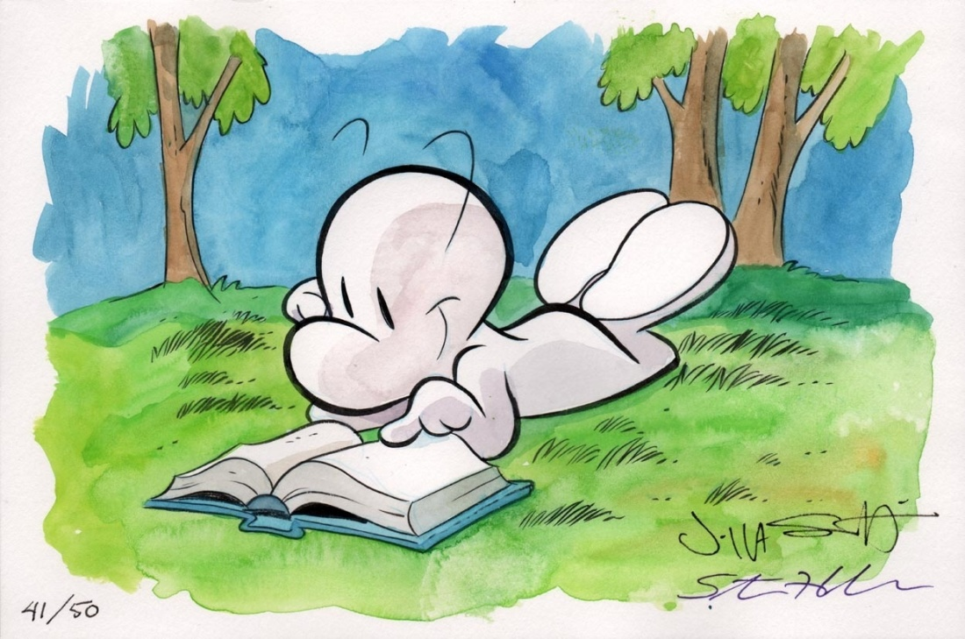
Importance of Graphic Novels
Provide a visual connection
Scaffolding for difficult concepts
Motivate students to read
Popular culture
Permanent, unlike moving pictures
Bone by Jeff Smith
Notes:
Visual Connection - The visual aspect of graphic novels helps students develop a connection to the text. Many students are not able to make pictures in their head as they read; by having the picture there for them, they are able to see what is happening as they learn more about the characters / events through the text.
Scaffolds - The text and visual combination of graphic novels aids students with their independent reading by providing scaffolding, much as a teacher would do through in-class tasks. For many students, seeing the pictures and reading the text is the extra boost they need to understand the story or concept.
Motivates - Graphic novels provide motivation by being fun to look at and interesting to follow. Many teachers have noted that their students consume comics, including graphic novels, more readily than they do other types of reading.
Popular - As teachers, we know that our students are highly influenced by what is popular. The last decade has seen a slew of comics turned into well-received movies, such as Spiderman and Batman. This popularity extends beyond the screen and back to the comics from which they were created. Comic book sales, including graphic novels, have seen a consistent increase in sales for the last decade as well. This furthers the notion that graphic novels are popular and students are thus motivated to read them.
Permanent - While videos also provide a visual, they are not fixed in time. If a student doesn’t hear something or see something in a video during class, they miss that information whereas. Graphic novels can be read slowly or quickly because the pictures are permanently fixed. This allows students the time they need to full comprehend the information.
Source: http://geneyang.com/comicsedu/strengths.html

Slide 16
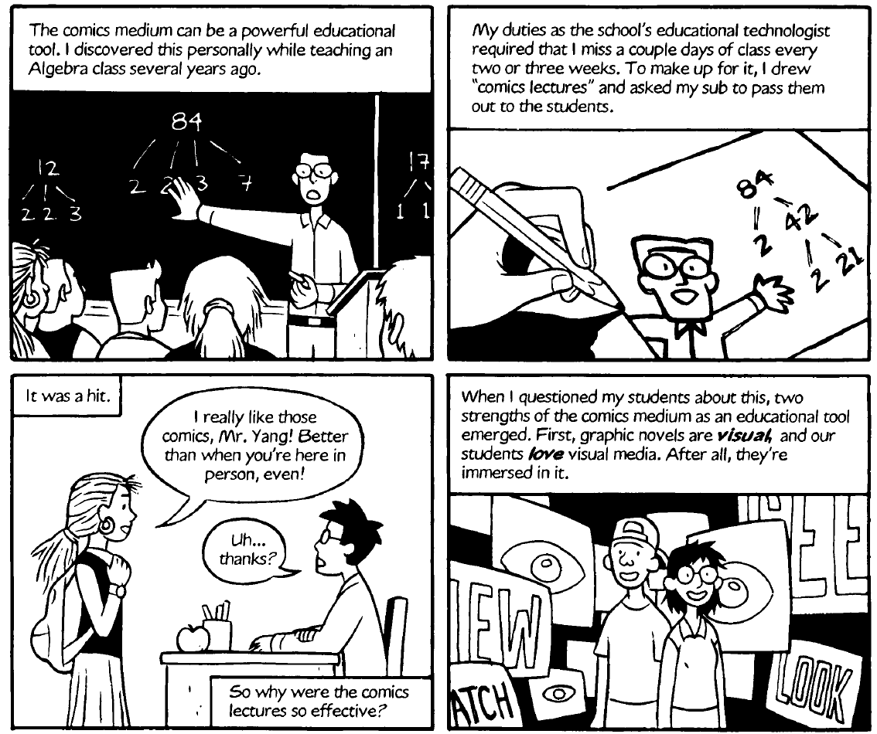
Benefits
Notes:
Students enjoyed the comic version of the lesson because it provided them with the visual and text connection.
Students frequently surround themselves with media ranging from television and movies to computers and smart phones.
Source: Yang, G.(2008).Graphic novels in the classroom. Language Arts, 85(3), 185.March 10, 2013.Retrieved from http://intranet.ecu.edu/cs-lib/trc/upload/Gene_Yang_article.pdf.

Slide 17
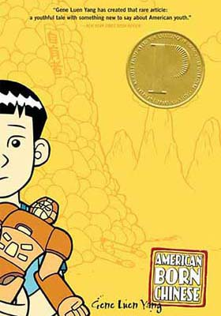
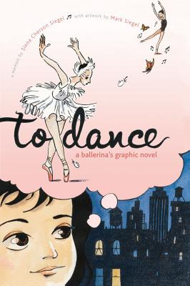
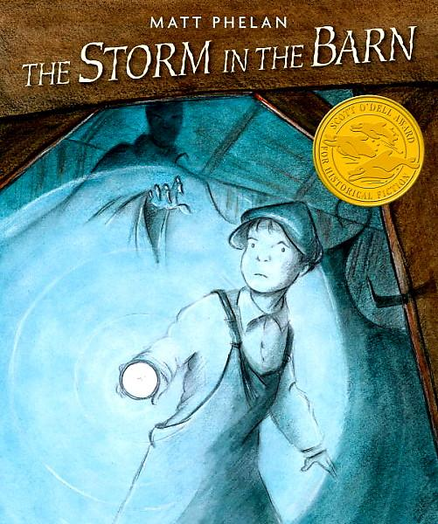
Inform Professional Practice
Gaining recognition in academia
Maus by Art Spiegleman won the Pulitzer Prize
National Book Award Finalist - American Born Chinese by Gene Yang
Sibert Honor Book – To Dance by Siena Siegel and Mark Siegel
Scott O’Dell Award Winner – Storm in the Barn by Matt Phelan
Notes:
These popular books are helpful in teaching difficult topics:
Maus focuses on the true story of Art Spiegelman’s father and surviving Nazi Germany. Winner of the Pulitzer Prize, this book is now commonly read and taught in college courses around the nation.
Gene Yang’s American Born Chinese weaves three storylines together as each protagonist tries to solve their problem.
Source: Moeller, R. A. (2013). Convincing the naysayers. Knowledge Quest, 41(3), 12-17.

Slide 18
Informs Professional Practice
Meeting the Common Core for ELA
Read grade level material independently
ELL’s, boys, and struggling readers are interested in graphic novels
They like the pictures
More confident in their reading
Notes:
Best practices dictate the need to teach meeting the standards. Using graphic novels allows one ways for teachers to do that.
CCSS ELA Literacy Standard 10 for grades 6-8: By the end of the year, read and comprehend literature, including stories, dramas, and poems, in the grades 6–8 text complexity band proficiently, with scaffolding as needed at the high end of the range.
Graphic novels allow students, especially struggling or unmotivated readers, scaffolding to aid comprehension of difficult grade level texts.
Source: Brozo, W. G. (2012). Building bridges for boys: Graphic novels in the content classroom. Journal of Adolescent & Adult Literacy, 55(6), 550.
Source: Howard, R. M. (2012). ELLs’ perceptions of reading.Reading Improvement, 49(3), 113-126.March 9, 2013.Retrieved fromhttp://ezproxy.csp.edu/login?url=http://search.ebscohost.com/login.aspx?direct=true&db=aph&AN=82186311.

Slide 19
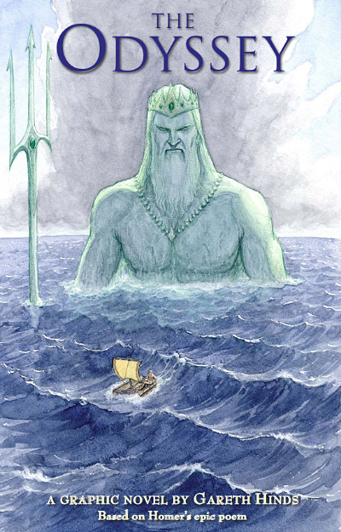
Inform Professional Practice
Graphic novels & best practices in literacy
Morrow & Gambrell (2011)
Foster literacy motivation
Authentic meaning-making purposes
Example: for pleasure
Scaffolded instruction
Self-selected independent reading
High-quality literature, many genres
Notes:
Create a classroom culture that fosters literacy motivation – Several of my resources show that students are motivated to read graphic novels because they find them enjoyable, connecting with the next idea…
Teach reading for authentic meaning-making purposes: for pleasure – Again, students like reading graphic novels and choose to read them for fun.
Provide students with scaffolded instruction – The graphics provide a visual scaffolding of the text, aiding the student even when the teacher is not there to help.
Give students time for self-selected independent reading – Allow time for students to choose and read graphic novels they enjoy. At least allow graphic novels to be an independent reading choice.
Provide students with high-quality literature across wide range of genres – Just as with other forms of literature, graphic novels are available in a variety of genres and difficulties. It is important to preview the graphic novels before making them available to students, but there are many high-quality graphic novels to choose from.
Source: Morrow, L., & Gambrell, L. (2011). Best practices in literacy instruction (4). New York, NY: The Guilford Press.

Slide 20
Graphic Novel Research in the Classroom

Slide 21
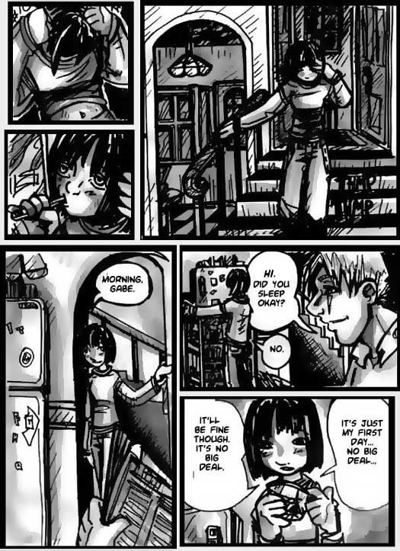
Graphic Novels in the Classroom
Lesson: How to read graphic novels
Top to bottom, Left to right
Address unusual panels
Visuals vs. Text
Making inferences
Demonology 101 by Faith Erin Hicks
Notes:
We will do a pre-reading activity to prepare for reading graphic novels. We will start with a book walk, examining the cover, title, author, and any text on the back. Then we will share how to read the panels, including techniques used by graphic artists to draw the eye in.
Afterwards, we will start reading Rapunzel’s Revenge and sharing our reactions to the pages. It will be important to discuss what is happening in both the text and the graphics, since they combine to tell the whole story.
When I feel that students understand how to read graphic novels sufficiently, I will have them read one on their own and complete a book review or make a bookmark as a final project.

Slide 22
Graphic Novels: Classroom Research
Read Rapunzel’s Revenge as a class
Discuss what we see
Share reactions to the text and graphics
Read graphic novel of choice on own
Be prepared to present to group

Slide 23
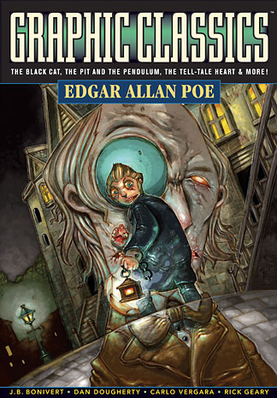
Graphic Novels: Classroom Research
Action research project
Does comprehension increase graphic novels?
Compare and contrast Poe short stories
Original text vs. graphic novel
Notes:
I plan to conduct action research in my classroom to show whether or not graphic novels do increase comprehension when reading the same story. My hypothesis is that it will help, but I haven’t found any quantitative data to support this yet.
I will split the students by gender and NWEA MAP testing scores so that there will be a mix of boys and girls of varying scores in each group. They will start with a pretest. Then, they will meet in small groups to read William Wilson and The Cask of Amontillado. I will provide each group with the same scaffolding activities, but will not otherwise assist them. This will help ensure that only the text is responsible for aiding comprehension, and not the teacher. After reading each short story and discussing in groups, all will take the posttest. I will then interview each to determine whether or not they felt the graphic novel aided their understanding of the story.
This data will be used to support my research and hopefully help me determine whether or not graphic novels aid comprehension.

Slide 24
Graphic Novels: Classroom Research
Control group and experimental group
Pretest
Observations
Posttest
Interviews

Slide 25
Graphic Novels: Classroom Research

Slide 26
Graphic Novels: Classroom Research

Slide 27
Incorporating Graphic Novels in the Classroom

Slide 28
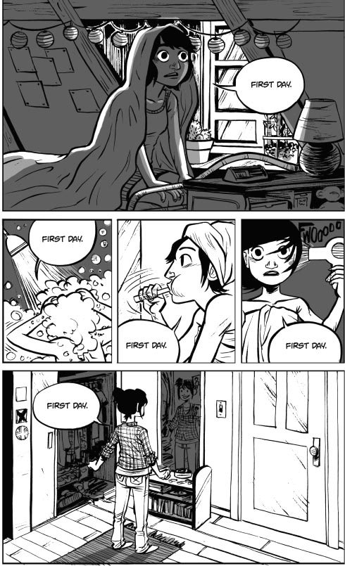
How to Use Graphic Novels - Art
Teach students how to read the art
Facial expressions, body language
Making inferences with pictures
Examine Elements of Art
How do they use line to convey…?
Describe emotion of the colors / values.
How is the space in this panel used?
Friends with Boys by Faith Erin Hicks
Notes:
In an Art Classroom

Slide 29
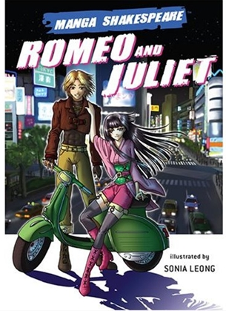
How to Use Graphic Novels - English
Preview Romeo and Juliet with manga version
Students become familiar with the storyline
meaning behind the pictures and the text
Then introduce them to the original Shakespearean story
Students use their background knowledge
Build new understandings of original text
Notes:
In an English classroom…

Slide 30
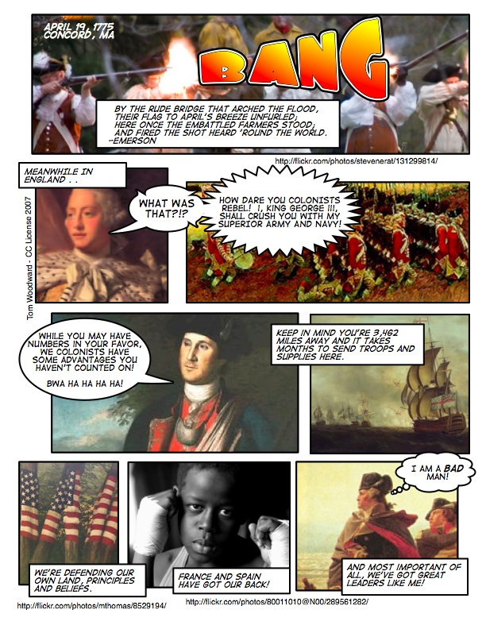
How to Use Graphic Novels – Social Studies
Students research a historical event
Then they find period art / photography
Use ComicLife Program
students insert the art / photography
Add historically relevant text

Slide 31
How to Use Graphic Novels - Math
Teachers can create comics to explain difficult math concepts
Visuals help students make sense of abstract concepts
Students can show mastery by creating a comic
Share with the class
People remember 95% of what they teach others

Slide 32
Make Beliefs Comics – 3 Panel Comics
Notes:
Talk about the importance of character positioning. When should they face each other, face away, look at the “audience”? What expressions should they make? Why?

Slide 33
Quick Lesson: Creating a Graphic Novel

Slide 34
Tips for Making a Graphic Novel
Step 1 – Brainstorm story ideas.
Step 2 – Practice sketches, focusing on a character or location.
Step 3 – Elaborate on your brainstorm.
Describe: characters, setting, conflict

Slide 35
Tips for Making a Graphic Novel
Step 4 – Make thumbnail sketches to outline your story; can include script.
Once upon a time…

Slide 36
Tips for Making a Graphic Novel
Step 5 – Pencil in each graphic novel page.
Step 6 – Edit and revise your rough draft.
Step 7 – Ink in your final copy. Color (opt).

Slide 37
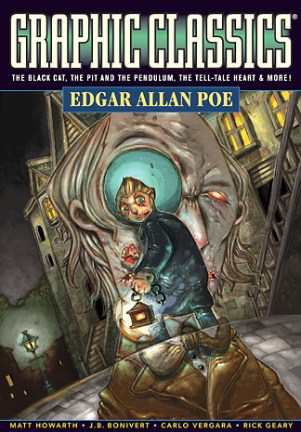
Graphic Novel Recommendations
Graphic Classics: Edgar Allan Poe (4th Ed.)
A variety of Edgar Allan Poe’s short stories are put into a graphic novel format as dark and mysterious as the author himself. Your students will be actively engaged as they delve into Poe’s disturbing tales of revenge, love, and loss.

Slide 38
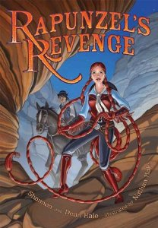
Graphic Novel Recommendations
Rapunzel’s Revenge by Dean, Shannon, & Nathan Hale.
The classic tale of Rapunzel is revisited in this Wild West inspired graphic novel. Join Rapunzel and Jack (of the Beanstalk) as they try to save the kingdom from the evil witch. This novel is perfect for grades 5 & up.

Slide 39
Thank you for your time ☺
Please get your Certificate from me
For more graphic novel ideas, please don’t forget to check out:
http://teaching.casadelindquist.com/

